Slide 1
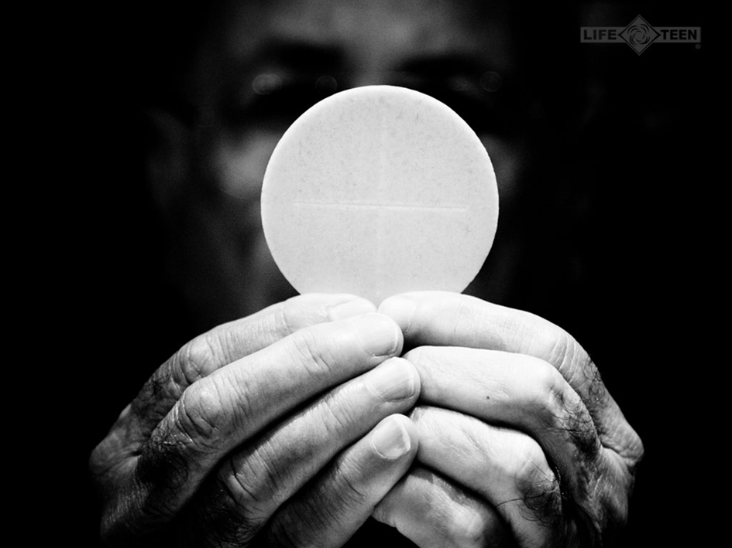
The Presence of Christ
Serving Christ
and the Church
in your Parish

Slide 2
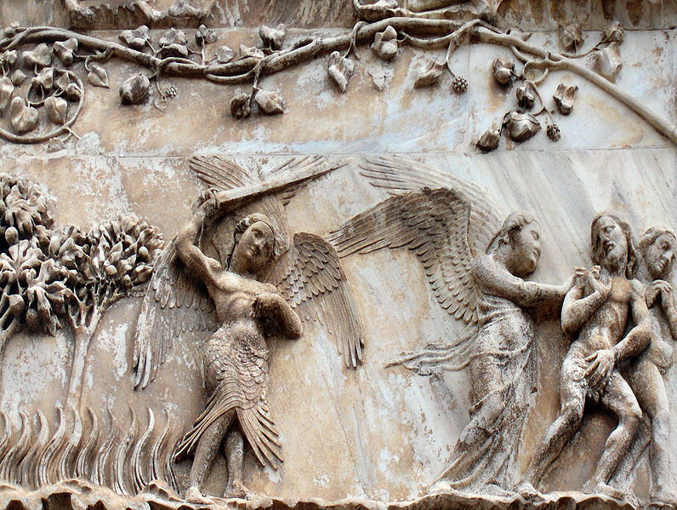
In the beginning…
The Fall of Adam and Eve.
Genesis 3:15 and the promise of redemption.
Old Testament events are a foreshadowing (typology) of New Testament fulfillment.
"Expulsion from Paradise", marble bas-relief by Lorenzo Maitani on the Orvieto Cathedral, Italy

Slide 3
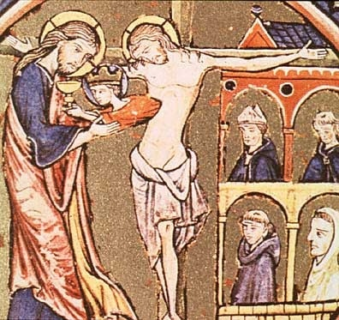
Redemption through the Ultimate Sacrifice by God Himself
Redemption accomplished by God Himself.
Reversal of typology in Genesis.
Church given sacramental power and authority.
Grace provided through
sacraments.
Christ giving birth to Ecclesia.
Illuminated ms. ca. 1220s.

Slide 4
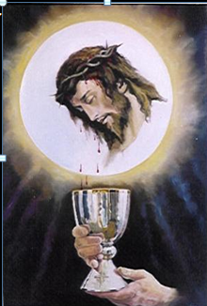
Christ is Present in the Mass
Christ is Present in the Mass in four ways:
1) In the priest (in persona Christi)
2) In the congregation (as the Body of Christ; Romans 12:4)
3) In the Word (John 1:1)
4) In the Eucharist (Mt 26:26)
Sacrosanctum Concilium 7

Slide 5
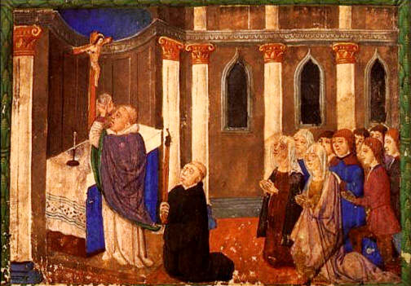
Liturgy As the Public Worship of the Church
“Liturgy” originally meant “a public work” or a “service in the name of/on behalf of the people” (CCC 1069)
Christian liturgy is the
participation of the
People of God in
“the work of God”

Slide 6
Participation in “the work of God”
Christian liturgy is our participation in Christ’s work of redemption, principally through the re-presentation of His self-offering to the Father in the Holy Sacrifice of the Mass and the Holy Eucharist
(cf. CCC 1069)

Slide 7
Liturgy and Redemption
“Through the liturgy Christ . . . continues the work of our redemption in, with and through his Church.” (CCC 1069)
The liturgy is the official public worship of the Church, in which the Body is united with the Head by the Spirit to offer perfect glory and praise to God the Father

Slide 8
The Celebration of the Eucharist
“The Source and Summit of the Christian Life”
Lumen Gentium, 11; CCC, 1324.

Slide 9
What is the Mass?
In the Eucharistic sacrifice, all creation is presented to the Father through the death and Resurrection of His Son and the Eucharist thus becomes a sacrifice of thanksgiving. (CCC 1359, 1360)
The Eucharist is also a sacrifice of praise, in which the Church glorifies God on behalf of creation through Christ. Because He has united Himself to us, our praise is united to His and through Him us becomes acceptable to the Father. (CCC 1361)

Slide 10
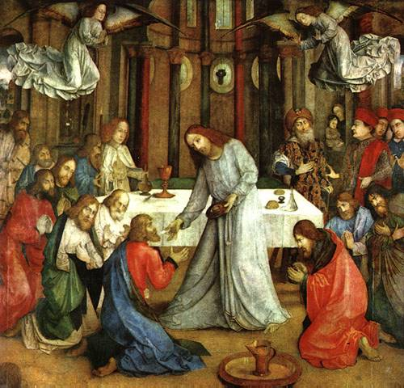
The Compendium of the Catechism of the Catholic Church Question 272. When did Jesus Christ institute the Eucharist?
Jesus instituted the Eucharist on Holy Thursday “the night on which he was betrayed” (1 Corinthians 11:23), as he celebrated the Last Supper with his apostles.

Slide 11
The Compendium of the Catechism of the Catholic Church Question 273. How did he institute the Eucharist?
After he had gathered with his apostles in the Cenacle, Jesus took bread in his hands. He broke it and gave it to them saying, “Take this and eat it, all of you; this is my Body which will be given up for you”. Then, he took the cup of wine in his hands and said, “Take this and drink of this, all of you. This is the cup of my Blood, the Blood of the new and everlasting covenant. It will be shed for you and for all so that sins may be forgive. Do this in memory of me”.

Slide 12
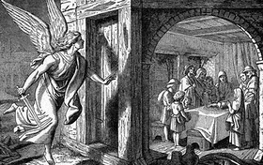
The Compendium of the Catechism of the Catholic Church Question 276. Where does the Eucharist fit in the divine plan of salvation?
The Eucharist was foreshadowed in the Old Covenant above all in the annual Passover meal celebrated every year by the Jews with unleavened bread to commemorate their hasty, liberating departure from Egypt.

Slide 13
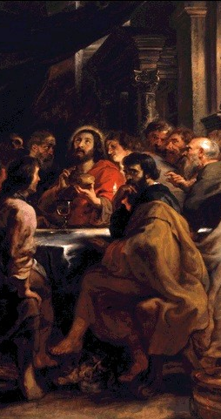
The Compendium of the Catechism of the Catholic Church Question 276. Where does the Eucharist fit in the divine plan of salvation?
Jesus foretold it in his teaching and he instituted it when he celebrated the Last Supper with his apostles in a Passover meal. The Church, faithful to the command of her Lord, “Do this in memory of me” (1 Corinthians 11:24), has always celebrated the Eucharist, especially on Sunday, the day of the Resurrection of Jesus.

Slide 14
Sacrificial memorial of Christ the Son, and His Body, the Church (CCC 1357-58)
Christ’s command to “do this in memory of me” is carried out by celebrating the memorial of His sacrifice, not just His remembrance. (CCC 1341 and 1357)

Slide 15
Christ’s one Sacrifice
Because the offerings of bread and wine become the Body and Blood of Christ, the Eucharist makes present and offers sacramentally Christ’s one Sacrifice, and therefore is the memorial of His Passover.

Slide 16
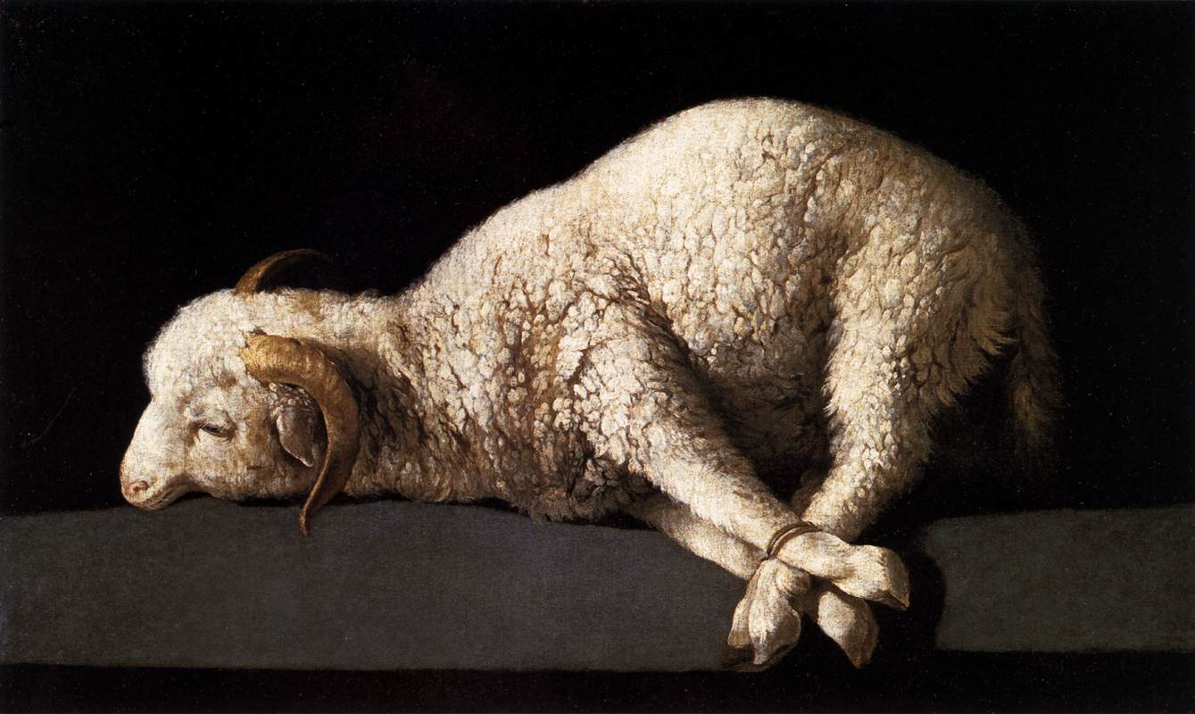
The anamnesis does not merely recall past events, but as the Passover Feast represented the Exodus, the memorial proclaims anew the mighty works of God for men so that they become present and real in a unique way. (CCC 1363)

Slide 17
The Eucharist is a Sacrifice
Because it is the memorial of Christ’s propitiatory death, the Eucharist is a sacrifice. In it, Christ gives us the very Body and Blood which was given up and poured out for us on the Cross. (CCC 1365)

Slide 18
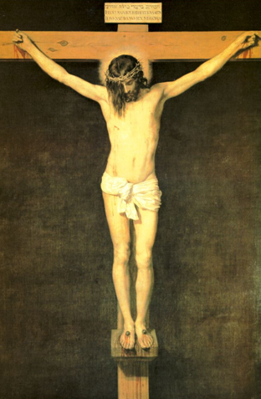
Re-presents the One
“The Eucharist is thus a sacrifice because it re-presents (makes present) the sacrifice of the cross, because it is its memorial and because it applies its fruit.” (CCC 1366)
Christ’s sacrifice and the sacrifice of the Eucharist are the same sacrifice!

Slide 19
Offered in an unbloody manner
The Victim who once offered Himself in a bloody manner is now offered in an unbloody manner through the ministry of the priests who stand in persona Christi. (CCC 1367)
As the Body of Christ, the Church participates in His sacrifice and with Him is also offered and also intercedes for all men. Thus, the Eucharist is also the sacrifice of the Church. (CCC 1368)

Slide 20
Joined to this Sacrifice
The members of the Body therefore also join in this sacrifice, which gives new and eternal value to their lives, sufferings, works, joys, and prayers.

Slide 21
Active Participation in the Eucharist
Pope Benedict reminds us, that the idea of the "active participation" of everyone in the opus Dei, in what happens in the worship of God.” is one of the key idea of Second Vatican Council.
(The Spirit of the Liturgy, 171)

Slide 22
What is active participation?
This does not mean that as many people as possible, as often as possible need to be involved but that everyone takes part in the action of liturgy.
As the Holy Father points out, “the word ‘participation’ refers to a principal action in which everyone has a ‘part’.” (The Spirit of the Liturgy, 171)

Slide 23
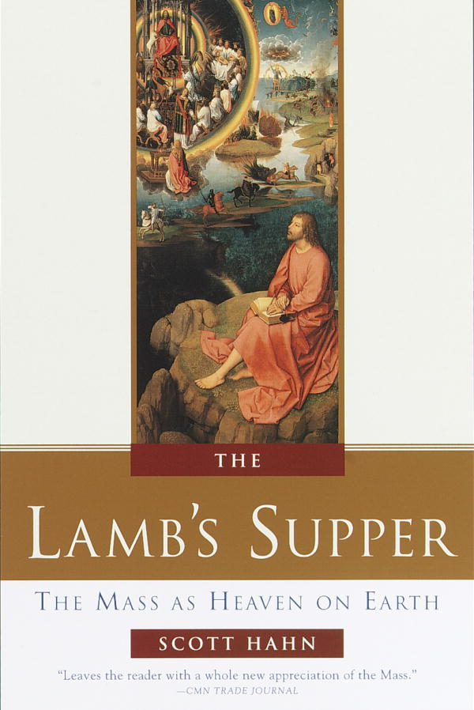
Protestant Convert Scott Hahn Describes his Discovery of the Mass…
Reading from The Lamb’s Supper, p. 9, Holy Smoke!
Notes:
“Each time I went back [to Mass], I would ‘‘discover’’ more of the Scriptures fulfilled before my eyes. Yet no book was as visible to me, in that dark chapel, as the Book of Revelation, the Apocalypse, which describes the worship of the angels and saints in heaven. As in that book, so in that chapel, I saw robed priests, an altar, a congregation chanting ‘‘holy, holy, holy.’’

Slide 24
Unites us to the Heavenly Liturgy
The Eucharistic celebration unites us to the heavenly liturgy and anticipates eternal life. (CCC 1326)

Slide 25
Earthly Liturgy is a Foretaste of Heavenly Worship
Thus we are given power to live the new life of Christ, to bear much fruit and so to enter the Kingdom of Heaven
The liturgy makes the Church present in the world as a visible sign of communion between God and man (CCC 1071)

Slide 26
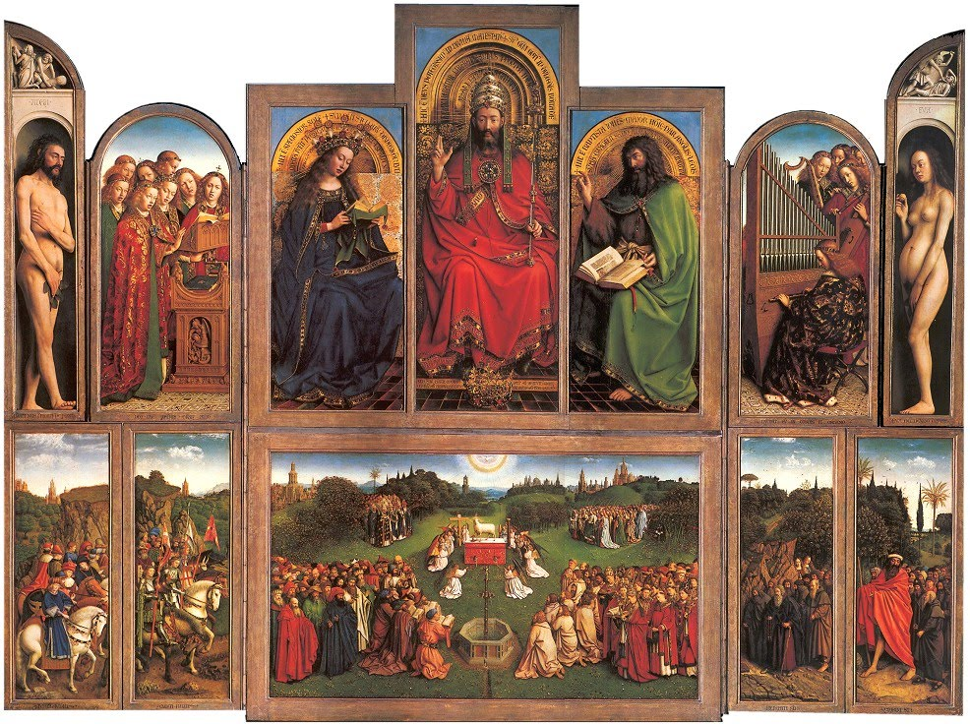
The Ghent Altarpiece 1432. Tempera and oil on wood, Cathedral of St. Bavo, Ghent, Belgium

Slide 27
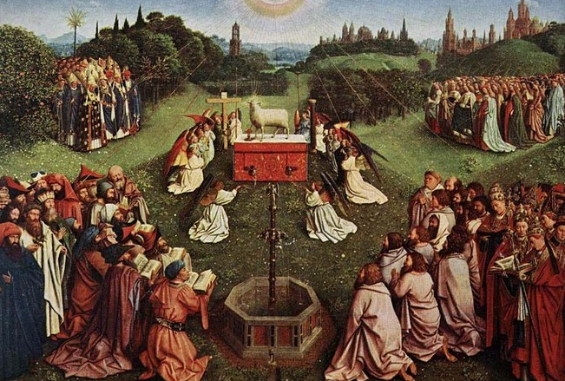

Slide 28
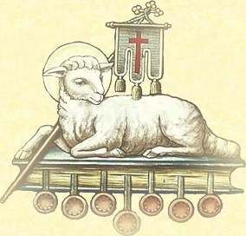
A Foretaste of Heaven
The earthly liturgy is a foretaste of the heavenly, when signs or images will pass away into the immediate reality of union with God (CCC 1090)

Slide 29
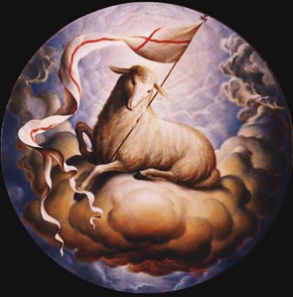
We take part in the heavenly liturgy…not a man-made thing, not a human invention.
Given to us by God Himself (1 Cor. 11:23).
Foreshadowing of the glory of Heavenly worship.
Reflected in church architecture.

Slide 30
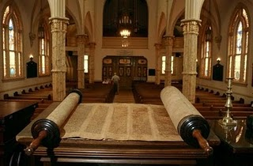
History of the Liturgy
Jewish roots of our liturgy
Temple worship
- Sacrifice
Synagogue worship
- Readings from Torah
- Preaching
- Intercessory Prayers
- Blessing

Slide 31
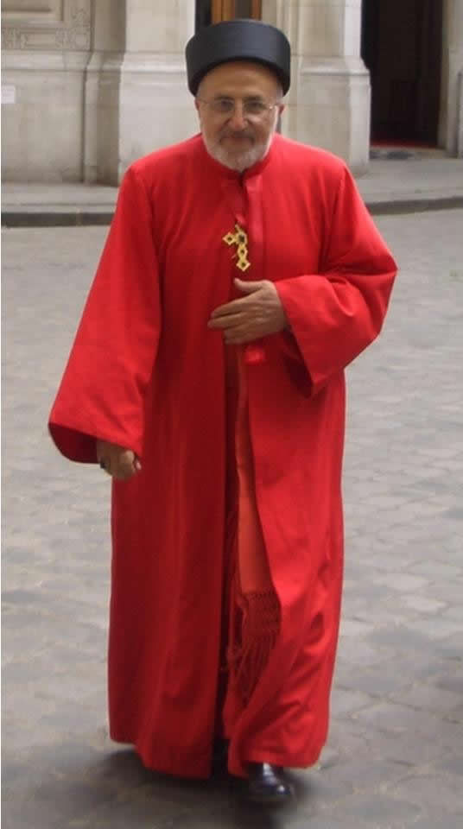
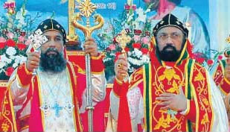
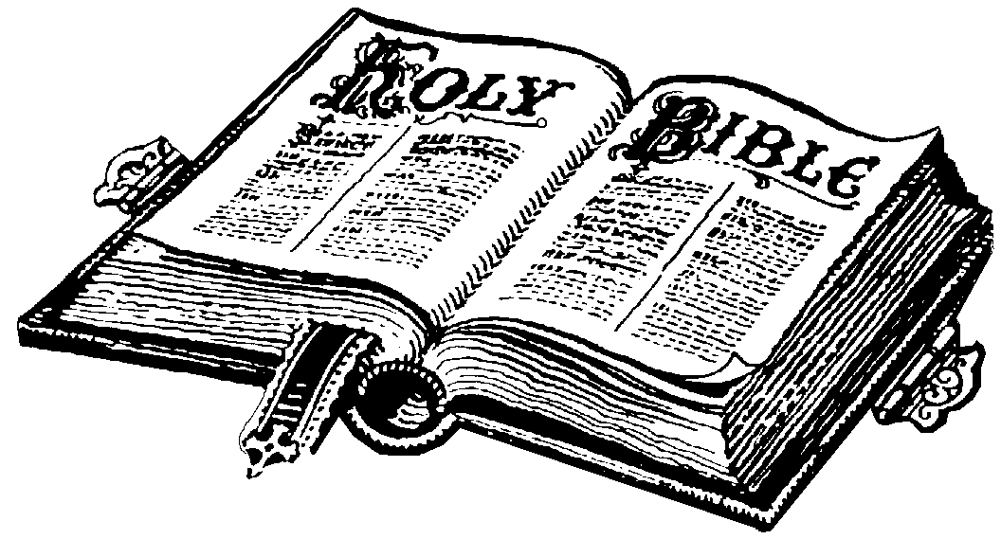
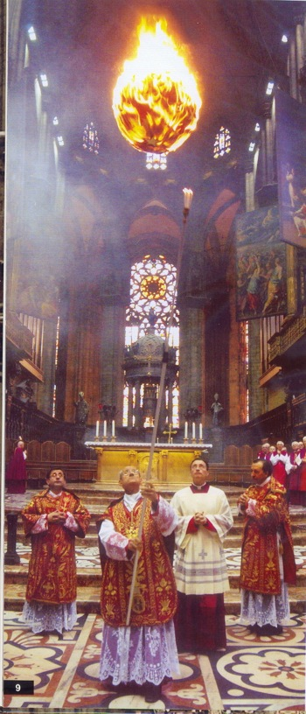
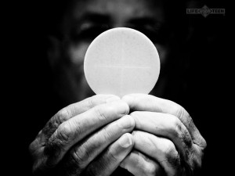
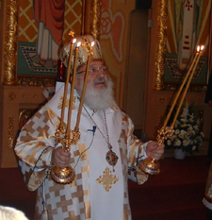
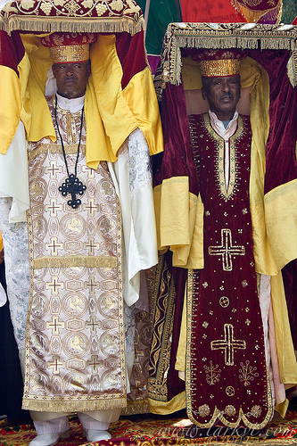
Era of Persecution
Persecution began (Acts 5)
Christians banned from the Synagogues.
Church persecuted by Jews then Romans for nearly three centuries.
Apostles went to the ends of the Earth.
Different regions/different liturgical customs
Same core.

Slide 32
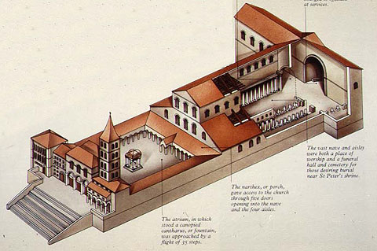
Christianity Freed
Constantine legalized Christianity in 313.
The Church of the catacombs was now free.
Huge wave of conversions.
Pax Romana – Roman Peace gave the Church access to the known world.
Church now had freedom to develop its worship based upon what God gave and what world had to offer.
Pope became new Pontifex Maximus.

Slide 33
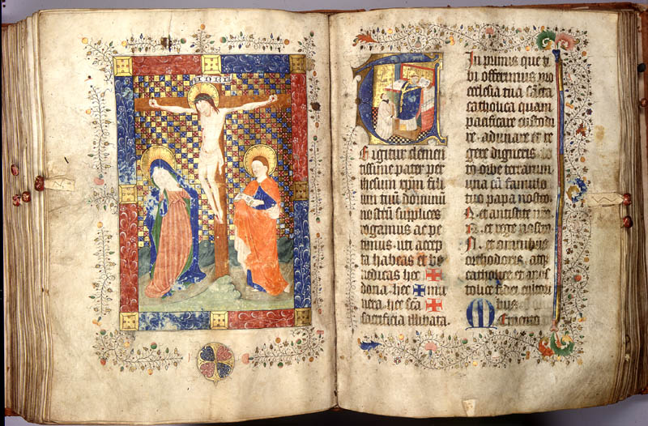
Influence of Roman Liturgy
The first Missals are written.
Pope’s missals most famous, most influential.
Rites in Rome gradually spread to much of the rest of the world.

Slide 34
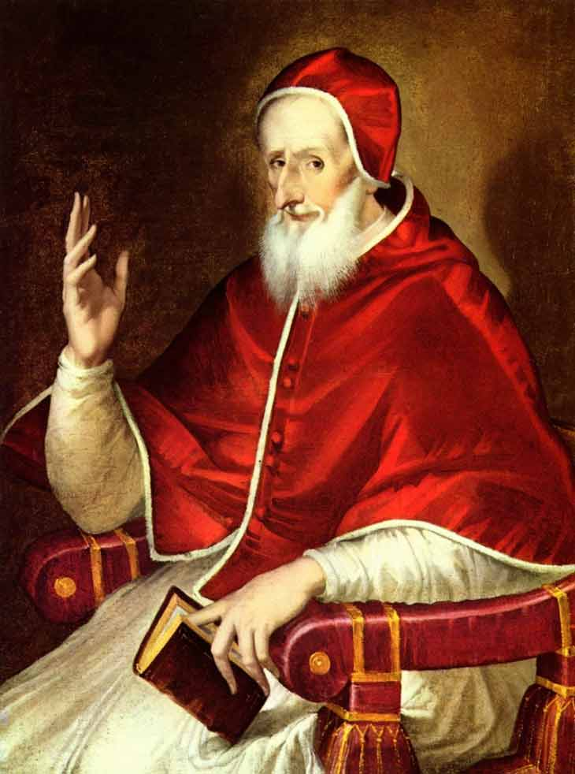
Since the Protestant Revolution
Protestant Revolution (1517 - )
Pius V revised the Roman Missal to stabilize liturgy in Church. (1570)
Made it universal and definitive in Roman Church.
Some organic changes before Second Vatican Council (1962-1965).
El Greco, Pius V, 1600-1610

Slide 35
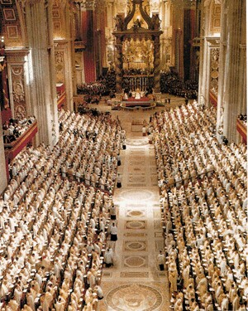
Liturgy after Vatican II
Sacrosanctum Concilium (1963).
The Council declares the Eucharist to be the Source and Summit of our faith (LG 11).

Slide 36
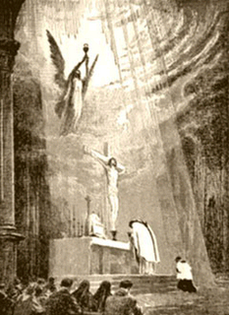
Two forms of the Roman Rite
In Summorum Pontificum (2007), Pope Benedict XVI makes it clear both Masses (1962 & 1970) are forms of one Rite.
Extraordinary Form (1962) & Ordinary Form (1970).
Both are valid and lawful.
No permission necessary.

Slide 37
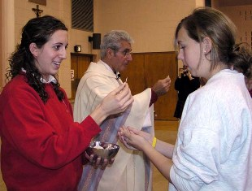
Two forms of the Roman Rite
New English translation of Roman Missal (Nov. 27, 2011!).
New Mass can be said in Latin or English. Old Mass only in Latin.
Extraordinary Ministers of Holy Communion only used at Ordinary Form (i.e. New Mass)

Slide 38
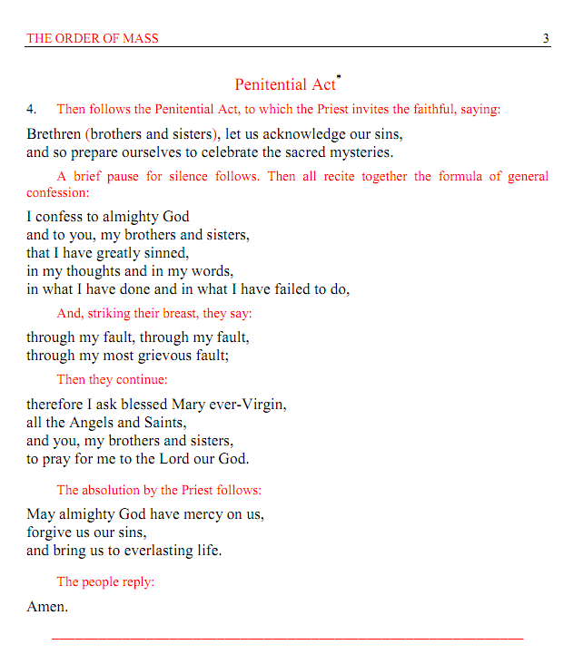
Need for Norms in the Liturgy
Say the Black. Do the Red.
Norms are designed with the intention of protecting the Eucharistic mystery.

Slide 39
(“say the black, do the red”)
This is why the Church has liturgical norms and public rituals and rubrics.

Slide 41
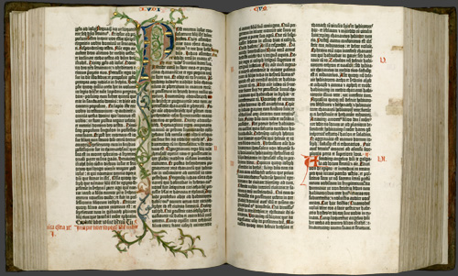
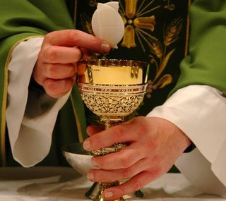
Structure of the Holy Mass
Form of the Mass has always had a two fold structure.
Table of God’s Word.
Table of the Eucharistic Sacrifice.
Together form one single act of worship.

Slide 42
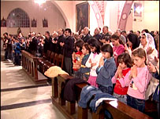
Presence of Christ in the Liturgy
When the Assembly gathers in his Name.
2. In the Priest who is the head of the liturgical assembly.
In His Word, especially the Gospel.
In the Eucharist (goes back to the need for norms)
We become even more the Body of Christ.

Slide 43
Ministry in the Church
Baptism the foundation of all ministry in the Church.
Marked for worship and set apart for service.
Service takes many forms.
Requirements
Baptized
Person of faith and prayer
Love for the Holy Eucharist
Seeks to serve the people of God
Continue to learn and grow in your faith

